Slide 1
An Introduction to Service Broker. Coaching Your Way Through
~ Wolf ~
Notes:
This template can be used as a starter file for presenting training materials in a group setting.
Sections
Right-click on a slide to add sections. Sections can help to organize your slides or facilitate collaboration between multiple authors.
Notes
Use the Notes section for delivery notes or to provide additional details for the audience. View these notes in Presentation View during your presentation.
Keep in mind the font size (important for accessibility, visibility, videotaping, and online production)
Coordinated colors
Pay particular attention to the graphs, charts, and text boxes.
Consider that attendees will print in black and white or grayscale. Run a test print to make sure your colors work when printed in pure black and white and grayscale.
Graphics, tables, and graphs
Keep it simple: If possible, use consistent, non-distracting styles and colors.
Label all graphs and tables.

Slide 2






Resources to use:
#sqlsatDC
#sqlhelp
#sqlserver
Notes:
Add slides to each topic section as necessary, including slides with tables, graphs, and images.
See next section for sample table, graph, image, and video layouts.

Slide 3

About Wolf
DBA for 15 years(5 MSSQL, 5 ORACLE, 5 MSSQL)
At RDX for nearly 5 years. “Manager – SQL Server Performance Tuning”
Works with a variety of clients and challenges
Notes:
Give a brief overview of the presentation. Describe the major focus of the presentation and why it is important.
Introduce each of the major topics.
To provide a road map for the audience, you can repeat this Overview slide throughout the presentation, highlighting the particular topic you will discuss next.

Slide 4
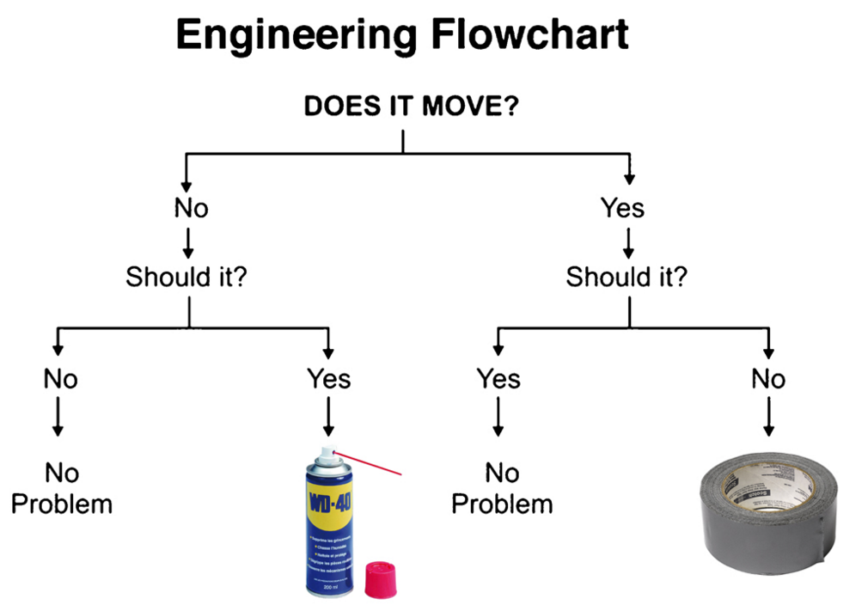
http://25.media.tumblr.com/tumblr_m1mnb7CvtP1rrr8v1o1_1280.jpg

Slide 5
What We Will Focus On
1
Service Broker Overview
2
Uses for Service Broker
3
Service Broker Objects
4
Service Broker, ETL/Replication alternative
Notes:
This is another option for an Overview slide.

Slide 6
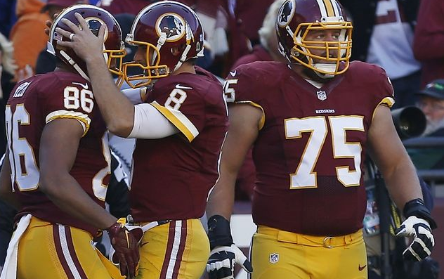
What is Service Broker?
ASYNCHRONOUS delivery and processing of messages
Messages are delivered in order
SQL Server uses Service Broker for Database Mail
Core feature since SQL Server 2005
http://cdn.fansided.com/wp-content/blogs.dir/136/files/2015/11/jordan-reed-kirk-cousins-nfl-new-orleans-saints-washington-redskins1-850x560.jpg
Notes:
Asynchronous delivery and processing of messages sent within a database or between databases (either on the same instance or in separate instances. Think of it as email processing

Slide 7
Uses For Service Broker
Asynchronous processing such as order fulfillment and credit card transactions
Near real-time ETL
Alternative to replication
Data Sharding

Slide 8
Key Terminology/Components
Message Types
Contracts
Queues
Services
Conversations
Endpoints
Routes

Slide 9
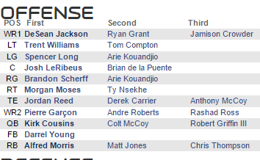
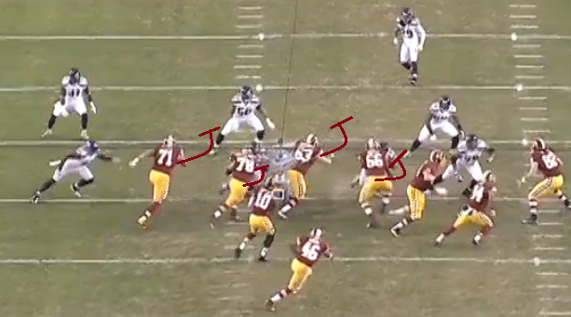
Message Types
Send Messages to/from databases on:
The same instance
Different instances, same server
Different Servers
CREATE MESSAGE TYPE sb_MessageType_Skins_Roster
AUTHORIZATION dbo VALIDATION= WELL_FORMED_XML
CREATE MESSAGE TYPE sb_MessageType_Skins_Plays_Processing
AUTHORIZATION dbo VALIDATION= WELL_FORMED_XML
www.nfl.com/teams/washingtonredskins/depthchart?team=WAS
cdn2.sbnation.com/imported_assets/1654859/Bounce1b.png

Slide 10
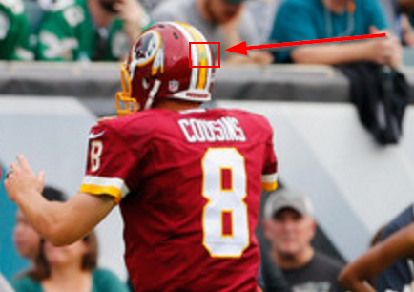
Contracts
Once Message Types are defined, Contracts are created to determine who is allowed to send messages, and in which direction
CREATE CONTRACT sb_contract_Skins_Plays_Processing
AUTHORIZATION dbo
(
sb_MessageType_Skins_Plays_Processing
SENT BY ANY)
GO
http://www4.pictures.zimbio.com/gi/Kirk+Cousins+Niles+Paul+Washington+Redskins+3bUfMCG-22jl.jpg

Slide 11
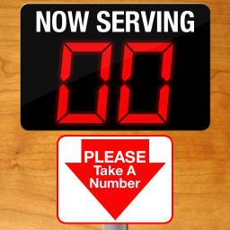
Queues
Message storage until the message can be handled
Possible to automatically activate a messaging handling system
CREATE QUEUE sb_queue_Skins_Plays_Processing
WITH
STATUS= ON,
RETENTION= OFF
GO
https://static-s.aa-cdn.net/img/ios/317787057/dda7d412fc6dbbdb65abc0ce6d3940d7?v=1
Notes:
Talk about the first 15 plays in redskins game being scripted

Slide 12
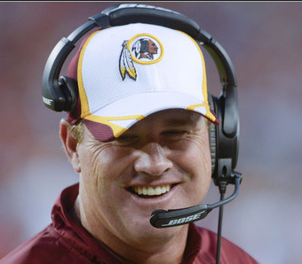
Services
Send messages to their queues or receive messages from other senders
CREATE SERVICE [sb_srvc_Skins_Alpha]
AUTHORIZATION WR01_ALPHA_User
ON QUEUE sb_queue_Skins_Alpha
([sb_contract_Skins_Sync])
GO
https://nflredskins.files.wordpress.com/2014/09/ap142681312335.jpg

Slide 13
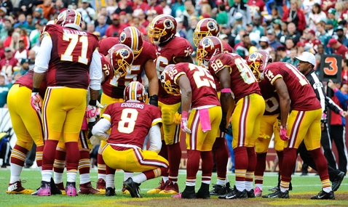
Conversations
This is the channel that the services send and receives messages from the queues
BEGIN DIALOG CONVERSATION @conversation_handle
FROM SERVICE @FromService
TO SERVICE @ToService
ON CONTRACT @Contract
WITH ENCRYPTION= ON;
SENDON CONVERSATION @conversation_handle
MESSAGETYPE @MessageType(@MessageBody);
http://thumb.usatodaysportsimages.com/image/thumb/540-390nw/8858127.jpg

Slide 14
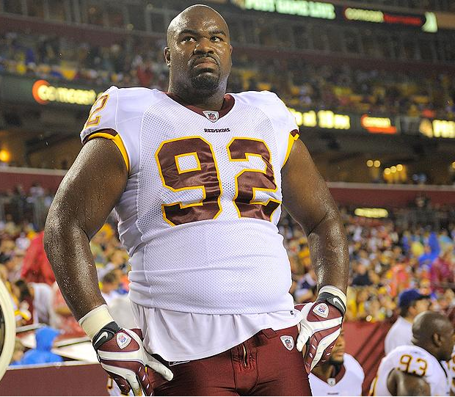
Poisoned Messages
http://cdn-jpg.si.com/sites/default/files/styles/si_article_main/public/images/albert-haynesworth-washington-redskins.jpg?itok=W6soaKlf

Slide 15
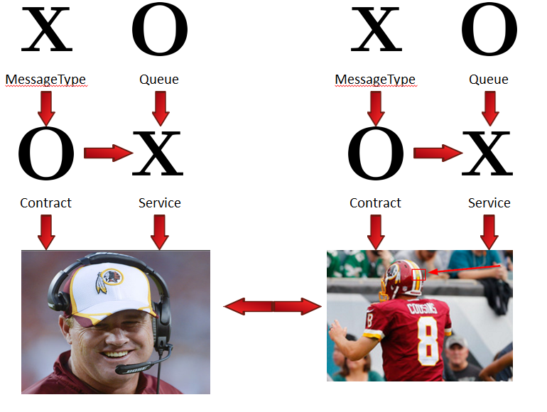
Will The Diagram Help?
https://nflredskins.files.wordpress.com/2014/09/ap142681312335.jpg
http://www4.pictures.zimbio.com/gi/Kirk+Cousins+Niles+Paul+Washington+Redskins+3bUfMCG-22jl.jpg

Slide 16
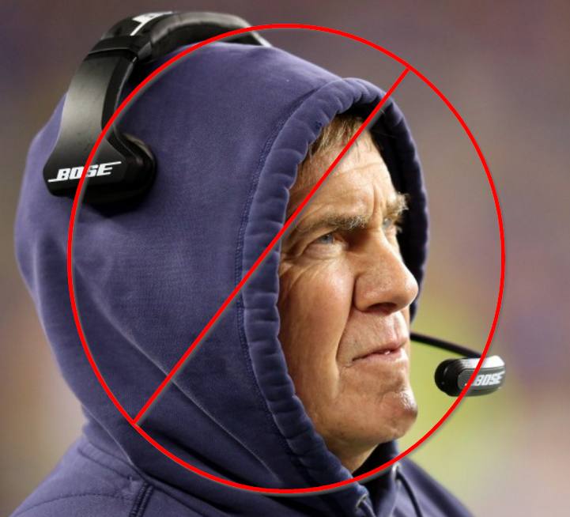
Demo
https://img.washingtonpost.com/wp-apps/imrs.php?src=https://img.washingtonpost.com/rf/image_908w/2010-2019/Wires/Images/2015-01-18/Getty/461744110.jpg&w=1484

Slide 17

Endpoints
A SQL Server endpoint is the TCP/IP point of entry into SQL Server.
This is how the service broker dialogs are directed
CREATE ENDPOINT WAREWOLF_ALPHA_Endpoint
STATE= STARTED
AS TCP ( LISTENER_PORT = 4022 )
FOR SERVICE_BROKER (AUTHENTICATION = WINDOWS );
GO
GRANT CONNECT ON ENDPOINT::[WAREWOLF_ALPHA_Endpoint] to [SQLWAREWOLF-LAP\sqlwarewolf]
GO
http://cnet1.cbsistatic.com/hub/i/r/2014/09/11/4fd0b9ca-10cc-46d8-a055-4c5fec2e05f3/resize/970x546/e04b33c5881a7cf1ca11b6bee139a9a6/icups.jpg

Slide 18

Routes
This is how SQL Server knows where to send our message
A route needs to be created in the database as well as MSDB
CREATE ROUTE sb_route_Skins_Wolfpack
AUTHORIZATION dbo
WITH
SERVICE_NAME = N'sb_srvc_Skins_Wolfpack',
ADDRESS = N'TCP://localhost:4023'
GO
USE msdb;
GO
create ROUTE sb_route_Skins_Alpha
AUTHORIZATION dbo
WITH
SERVICE_NAME = N'sb_srvc_Skins_Alpha',
ADDRESS = N'LOCAL'
GO

Slide 19
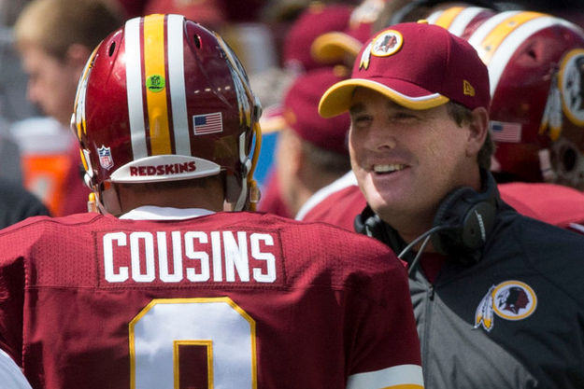
Remote Service Binding
Creates a “partnership” between the Remote Service and the local service.
Defines the security between the two
USE WashingtonRedskins
GO
CREATE REMOTE SERVICE BINDING [WR02_WOLFPACK_Binding]
AUTHORIZATION dbo
TO SERVICE N'sb_srvc_Skins_Wolfpack'
WITH USER = [WR02_WOLFPACK_User]
GO
GRANT SEND
ON SERVICE::[sb_srvc_Skins_Alpha]
TO WR02_WOLFPACK_User;
https://c2.staticflickr.com/6/5576/15221346236_1a1b019a26_b.jpg

Slide 20

Demo
http://www.obnoxiousbostonfan.com/wp-content/uploads/2015/01/NewEngland_logo-1.jpg

Slide 21
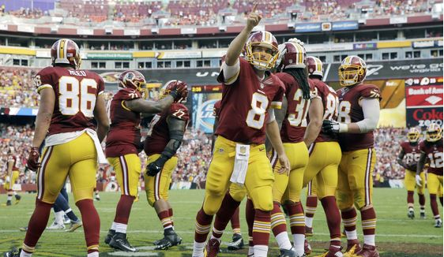
http://twt-thumbs.washtimes.com/media/image/2015/09/20/AP_617810272468_c0-55-4422-2632_s561x327.jpg?30e54dc05235ba9b05ef668810cf478043d27ad8

Slide 22
Resources
http://sqlblog.com/blogs/allen_white/archive/2010/01/06/service-broker-basics.aspx
http://itknowledgeexchange.techtarget.com/sql-server/using-service-broker-instead-of-replication/
http://www.sqldiablo.com/2012/03/04/service-broker-overview/
http://sqlperformance.com/2014/03/sql-performance/configuring-service-broker

Slide 23
Questions?

